Slide 1
Healthy Eating

Slide 2
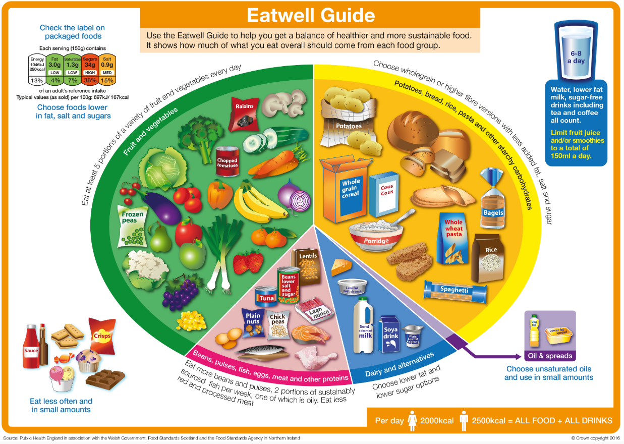
The food groups…
Eating a balanced diet is important for our health. Enjoy food from each of the five food groups and you’ll be getting a fantastic mix of the best nutrients and vitamins.

Slide 3
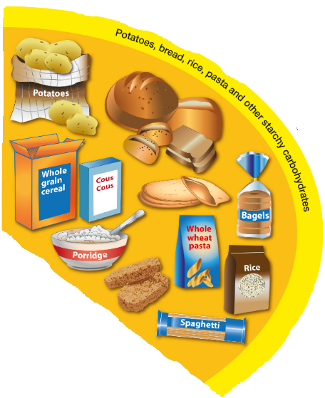
Carbohydrates
Carbohydrates give you energy, calcium and B vitamins. These could be servings of pasta, rice, oats, potatoes and sweet potatoes or noodles, yam, couscous, bread, barley and rye. Breakfast cereals are also a carbohydrate and many contain extra iron too.
What does one portion look like?
• One slice of bread, one roll or half a pizza
• Six tablespoons of breakfast cereal or porridge
• Four wholewheat crisp breads
• Six tablespoons of pasta, rice, millet or couscous
• Two small new potatoes
• Two tablespoons mashed sweet potato.
Servings per day?
3-5.

Slide 4
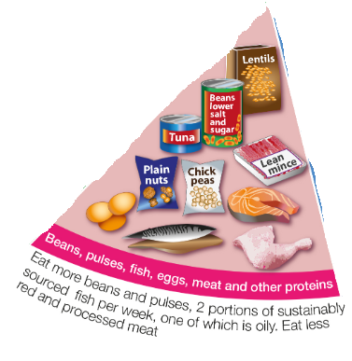
Protein
Think of proteins as building blocks for the body – they help it grow and repair itself. Protein is found in meat, fish and eggs, while nuts, beans, lentils, peas, dahl, Quorn and soya are great vegetable proteins. These foods also provide us with iron and other vitamins and minerals.
What does one portion look like?
• Two slices of cold ham, turkey and chicken
• One medium chicken breast
• Two sausages
• Three bacon rashers
• One beefburger
• One fillet of fish or fish steak
• One small can of tuna, salmon, mackerel, sardines
• Four fish fingers
• One cup of cooked lentils or beans
• Half a large can of beans, chickpeas or lentils
• A 100g portion of tofu or Quorn.
Servings per day?
2-3

Slide 5
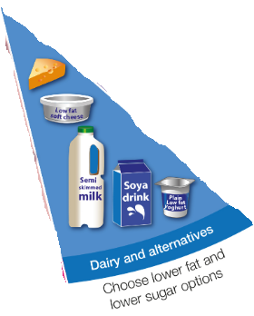
Dairy
Packed with calcium, protein and vitamins such as vitamins A, D and B12, dairy products keep our bones and teeth healthy. Our bodies easily absorb the calcium from these foods, such as milk, yoghurt, fromage frais and cheese.
What does one portion look like?
• One glass of milk
• One pot of yoghurt or fromage frais
• One matchbox-sized piece of cheese or two triangles
• Half a tin of low-fat custard.
Servings per day?
Aim for 3

Slide 6
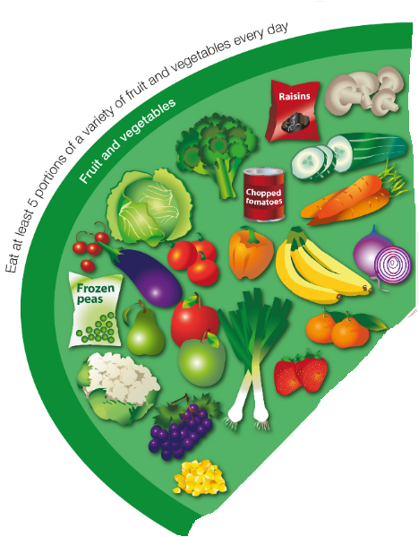
Fruit and Veg
Fruit and veg – fresh, frozen, tinned, dried and juices – are brilliant for our diets. They’re full of health-giving vitamins, antioxidants and fibre – that keep us feeling full and our digestive systems healthy – plus they’re low in calories. By eating a wide variety of fruit and veg, you’ll be getting a range of the important nutrients they contain.
What does one portion look like?
• One apple, orange, pear or banana or similar-sized fruit
• Two smaller fruits such as plums, satsumas or kiwi fruit
• A handful of small fruits such as grapes, cherries or berries
• Half to one tablespoon of dried fruits such as raisins, prunes or apricots
• A slice of large fruit such as a piece of melon or a slice of pineapple
• Three heaped tablespoons of raw, cooked, frozen or canned vegetables
• A dessert bowl of salad.
Servings per day?
At least 5.

Slide 7
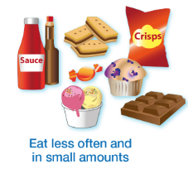
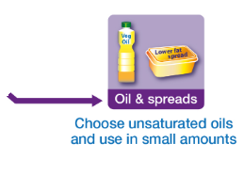
Fats and sugars
It’s important not to have too many foods from this group as they give us a lot of energy from calories but not much nutrition. Try to keep foods such as butter, margarine, cooking oils and salad dressings to a minimum and save chocolate, crisps, sugary soft drinks, sweets, jam, cream, cakes, pudding, biscuits and pastries for the occasional treat.

Slide 8
Challenge
Can you design a menu for each meal of the day that is:
1) Balanced (has something from each of the food groups)
2) In the correct proportions (more fruit and veg than proteins etc)
3) Contains the correct (or as near as possible) number of portions of each food group. E.g. 5 fuit and veg or 3 dairy.
4) Is delicious!

